Slide 1

Hard to Swallow?
A review of the quality of dysphagia care provided
to patients with Parkinson’s disease aged over 16 years
who were admitted to hospital when acutely unwell
Key messages and recommendations
Notes:
Presenter’s notes:
This presentation can be used to present the principal recommendations from the report ‘Hard to Swallow?’. This looked at the quality of dysphagia care provided to patients with Parkinson’s disease aged over 16 years who were admitted to hospital when acutely unwell. The study covered the whole of the UK including off-shore islands.
More information can be found at https://www.ncepod.org.uk/2021dysphagia.html

Slide 2
The study
A review of the quality of dysphagia care provided to patients with Parkinson’s disease aged over 16 years who were admitted to hospital when acutely unwell
Organisational questionnaire
Clinician questionnaire
Case note review
Patient/carer online survey
Notes:
Presenter’s notes:
The study described in this report aimed to examine the pathway of care for patients with Parkinson’s disease (PD) who were admitted to hospital when unwell, to explore multidisciplinary care and organisational factors in the process of identifying, screening, assessing, treating and monitoring of their ability to swallow.
The clinician caring for the patient at admission completed a questionnaire and returned this alongside copied extracts of the case notes. These data were peer reviewed by a multidisciplinary group of clinicians to assess the quality of dysphagia care patients had received. In addition, organisational data and the views of service users were collected.
The anonymous patient;/carer survey was circulated online to allow patients with PD who were admitted to hospital with dysphagia, or their carers, to provide their views on the care received as an inpatient.

Slide 3
Study population
Adult patients aged 16 and over with PD who were acutely unwell and admitted to hospital between 7th January and 3rd March 2019.
Exclusions
Patients admitted as a day case, as not enough data would be available for a review
• Patients who were admitted to Level 3 (ICU/ITU) critical care, as they may have been intubated
• Patients who were admitted to independent hospitals, as this group of patients were unlikely to be acutely unwell
Notes:
Presenter’s notes:
Patients were identified by ICD10 codes for PD in any position:
• G20 Parkinson’s disease
• G21.1 Other drug-induced secondary parkinsonism
• G21.2 Secondary parkinsonism due to other external agents
• G21.3 Postencephalitic parkinsonism
• G21.4 Vascular parkinsonism
• G21.8 Other secondary parkinsonism
• G21.9 Secondary parkinsonism, unspecified

Slide 4
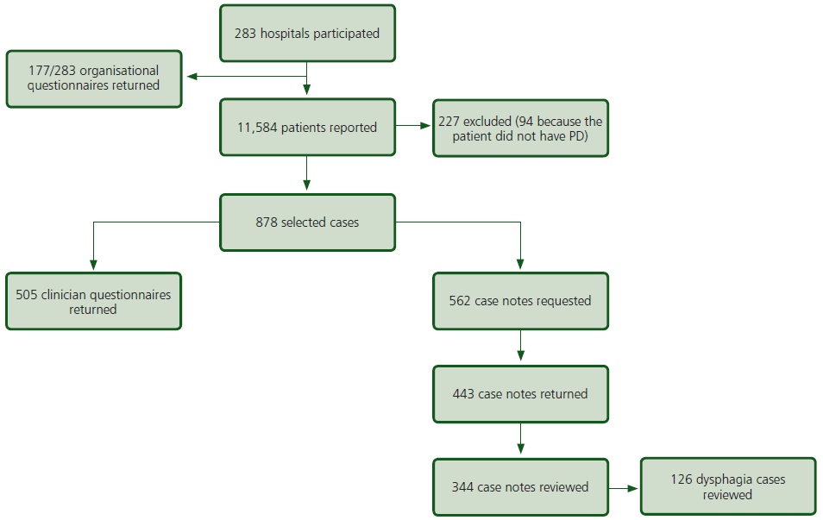
Study sample
Notes:
Presenter’s notes:
NB: As the number of patients identified as experiencing dysphagia was lower than expected, following receipt of the first 350 sets of notes, the case note request was amended to focus on those patients where the clinician indicated that the patient had any (or all) of the following:
• Indicators of dysphagia at some point during the admission
• Required modified diet/fluids
• Missed/had altered medication

Slide 5
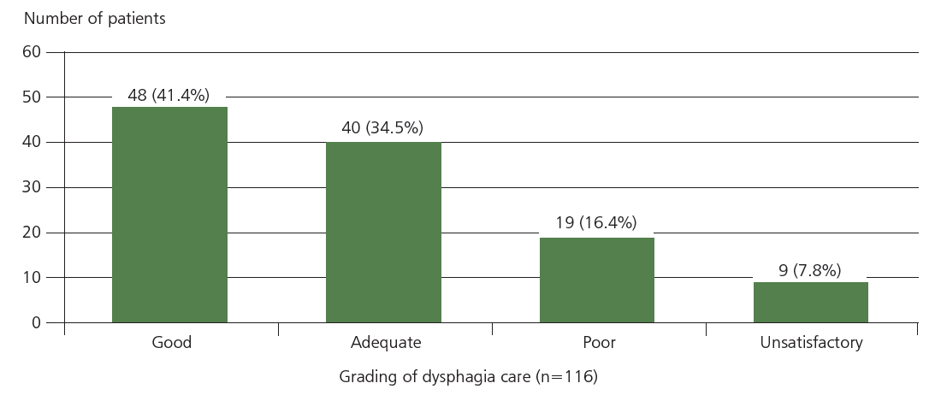
Overall assessment of dysphagia care
Figure 11.1 Assessment of the overall dysphagia care the patient received
during the admission
Case reviewer data
Notes:
Presenter’s notes:
The case reviewers assessed the overall dysphagia care the patient received during the admission. This was assessed to be good for 48/116 (41.4%) patients, adequate for 40/116 (34.5%) patients, and either poor or unsatisfactory for 28/116 (24.1%) patients.

Slide 6
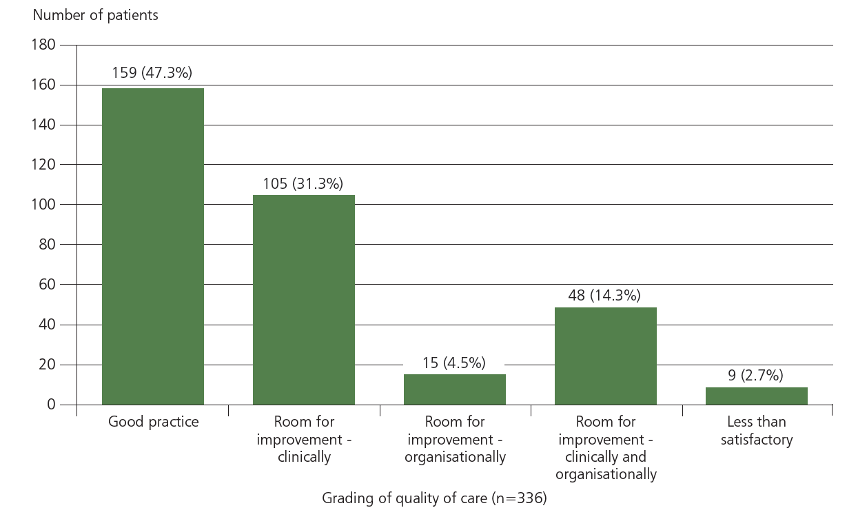
Overall assessment of care
Figure 11.2 Assessment of the overall quality of care the patient received while in hospital
Case reviewer data
Notes:
Presenter’s notes:
Case note reviewers assessed the overall quality of care for each case. 47.3% were felt to demonstrate good practice, whilst another ~ 45% showed room for improvement in clinical care.
The care of 9 patients was considered to be less than satisfactory.

Slide 7
Key messages (1)
Document the swallow status of all patients with Parkinson’s disease at the point of referral to hospital.
Since dysphagia can occur at every stage of PD it is important to assess and communicate its presence in a referral letter. Information relating to dysphagia was not available in the referral letter of 20/79 patients who were known to have dysphagia at the point of referral.
Notes:
Five key messages have been agreed as the primary focus for action, based on the report findings and recommendations (see pages 8-10 and Appendix 1).
Several areas of concern were highlighted in line with expectations for this group of patients, broadly relating to issues with the documentation of swallowing status; the screening of patients for dysphagia at admission; the referral of patients with swallowing difficulties to SLT; and the provision of information at discharge.

Slide 8
Key messages (2)
Screen patients with PD for swallowing difficulties at admission
Patients admitted to hospital may have swallowing difficulties, not recorded as ‘dysphagia’. Other indicators should be considered, such as the patient’s ability to swallow food, fluids or medication, whether they have control of saliva or have a history of pneumonia.

Slide 9
Key messages (3)
Refer patients with PD who have swallowing difficulties (or who have problems with communication) to speech and language therapy
Early input, as needed, from speech and language therapy (SLT) is fundamental to improving swallowing difficulties and communication for many patients with dysphagia. In this study referral to SLT was made following a swallowing screen on arrival for 51/209 (24.4%) patients and case reviewers were of the opinion that a further 36/132 (27.3%) patients should have been referred.

Slide 10
Key messages (4)
Notify the specialist PD service (hospital and/or community) when a patient with PD is admitted, if there is any indication that there has been a deterioration or progression of their clinical state
For any team caring for a patient with PD it is important to know if there has been any unexpected change in the patient’s clinical status or care plan. While a majority of patients in this study were under the care of a PD service prior to their admission, there was no evidence of contact with their PD service, on admission, documented in 180/316 (57%) sets of notes.

Slide 11
Key messages (5)
Provide written information at discharge on how to manage swallowing difficulties
At the point of discharge from hospital any changes in care or medication, as well as swallowing status (including the ability to take oral medication), nutrition plan or level of future risk of dysphagia should be provided to care providers as well as the patient and/family members.

Slide 12
Recommendation 1
Document the swallow status of all patients with Parkinson’s disease at the point of referral to hospital.
Target audiences: Primary care and community Parkinson’s disease teams
Notes:
Presenter’s notes:
The report, which makes eleven recommendations for clinicians and management to implement in practice, highlights there is room for improvement in the quality of dysphagia care.

Slide 13
Recommendation 2
Notify the specialist Parkinson’s disease service (hospital and/or community) when a patient with Parkinson’s disease is admitted, if there is any indication that there has been a deterioration or progression of their clinical state.
Target audiences: Healthcare professionals who see patients at admission, clinical and medical directors
Notes:
Presenter’s notes:

Slide 14
Recommendation 3
Screen patients with Parkinson’s disease for swallowing difficulties at admission, irrespective of the reason for admission. This should include:
• Ability to swallow food, fluids and medication
• Control of saliva
• A history of pneumonia
Target audiences: Healthcare professionals who see patients at admission and clinical directors
Notes:
Presenter’s notes:

Slide 15
Recommendation 4
Refer patients with Parkinson’s disease who have swallowing difficulties* (or who have problems with communication) to speech and language therapy.
Target audiences: Healthcare professionals who see patients throughout their admission and clinical directors
Notes:
Presenter’s notes:
Indicators of dysphagia included: Difficult, slow chewing or swallowing; Coughing or choking before, during or after swallowing; Change to consistency to food e.g. soft/puree diet; Difficulty controlling food or liquid in the mouth; Recurrent chest infections; Unintentional weight loss; Difficulty in swallowing pills; Prolonged time to complete a meal; Change in respiration pattern; Drooling; Drowsy; Food remaining in mouth; Prolonged chewing; Known dysphagia.
* Other responses provided – Wet voice quality, unexplained temperature spikes, food sticking in throat, hoarse voice, feeling of obstruction, avoiding particular foods e.g. dry/hard, heartburn, regurgitation of undigested food, avoiding social occasions, frequent throat clearing all <5 patients

Slide 16
Recommendation 5
Ensure patients are able to take the medication they have been prescribed at, and throughout, their admission. If there are concerns about whether or not the patient can swallow safely consider other formulations of medication (e.g. liquid rather than a tablet) or ways of administering them.
Target audiences: Healthcare professionals who see patients at, and throughout, their admission, pharmacists, and clinical directors
Notes:
Presenter’s notes:
NB: Levodopa should be administered within 30 minutes of the prescribed administration time. This is in line with NICE Quality Standard 164. See also the Parkinson’s UK medication optimisation consensus statement

Slide 17
Recommendation 6
Ensure there is a hospital policy for the different ways of administering medication and the review of medications at the point of patient discharge. This includes the use of rotigotine patches.
Target audiences: Clinical directors, medical directors, hospital pharmacists, specialist Parkinson’s disease teams and quality improvement leads
Notes:
Presenter’s notes:

Slide 18
Recommendation 7
Screen the nutritional status of patients admitted to hospital with Parkinson’s disease and act on the findings.
Target audiences: Clinical directors, dietitians, nutrition team members and healthcare professionals who see patients at, and throughout, their admission
Notes:
Presenter’s notes:
NB: All patients admitted to hospital should undergo a nutritional screen using a validated screening tool such as the BAPEN Malnutrition Universal Screening Tool (MUST) this in line with NICE Quality Standard 24

Slide 19
Recommendation 8
Involve speech and language therapists, pharmacists, dietitians and nutrition team members in any multidisciplinary (MDT) discussion of patients with Parkinson’s disease and swallowing difficulties.
Target audiences: Clinical directors, speech and language therapists, pharmacists, dietitians and nutrition team members
Notes:
Presenter’s notes:

Slide 20
Recommendation 9
Formalise pathways for the provision of modified texture diet and fluids to include input from:
• Speech and language therapists
• Pharmacists
• Dietitians or other nutrition team members
• Hospital housekeeping and catering services
• Community care
Target audiences: Medical directors, clinical directors, clinical teams caring for patients with dysphagia. This includes speech and language therapists, pharmacists, dietitians, hospital housekeeping and catering services, community Parkinson’s disease teams and quality improvement leads
Notes:
Presenter’s notes:
This recommendation is in line with the International Dysphagia Diet Standardisation Initiative (IDDSI)

Slide 21
Recommendation 10
Ensure there is a hospital policy for ‘risk feeding’ which includes the assessment or re-assessment (if already undertaken at admission) of mental capacity regarding this decision. The policy should state that discussion should involve:
• Patients
• Family members and/or carers
• Speech and language therapists
• Dietitians/nutrition team members
• Pharmacists
Target audiences: Clinical directors, medical directors, speech and language therapists, pharmacists, dietitians and nutrition team members and quality improvement leads
Notes:
Presenter’s notes:

Slide 22
Recommendation 11
Provide written information at discharge on how to manage swallowing difficulties, including:
• Swallow status
• Ability to take oral medication
• Changes to medication including any new ways of administering them
• Nutrition screening tool score and care plan including any texture modifications to food and/or fluids
• Positioning
• Level of dysphagia risk in the community
To:
• The patient
• Family members and/or carers
• Community healthcare professionals (e.g. GP, community PD team, community pharmacist, care home staff)
Target audiences: Clinical directors, healthcare professionals who see patients throughout their admission, quality improvement leads
Notes:
Presenter’s notes:
A proforma could be used for this discharge summary.

Slide 23
Discussion
Are all patients admitted with PD screened for dysphagia at admission?
Are patients with swallowing difficulties referred to SLT?
Is the patient’s ability to take their medicine monitored at and throughout admission?
Which specialties are involved with MDT discussions for patients with PD and swallowing difficulties?
Are pathways for the provision of modified texture diet and fluids formalised?
Is written information on how to manage swallowing difficulties provided at discharge?
Notes:
Final slide for the presenter to begin a discussion

Slide 24
Hard to Swallow?
Full report, summary and implementation tools are be found at
https://www.ncepod.org.uk/2021dysphagia.html
Notes:
https://www.ncepod.org.uk/2021dysphagia.html

